Slide 1


Gerome Andrew Ducduc 11-07-2023

Slide 2
Outline
Executive Summary
Introduction
Methodology
Results
Conclusion
Appendix
2

Slide 3
Executive Summary
The analysis of the data involved a combination of methodologies, including data collection through web scraping and the SpaceX API, exploratory data analysis (EDA) encompassing data wrangling, data visualization, and interactive visual analytics, as well as machine learning prediction. A summary of the findings is presented below.
Data collection involved utilizing web scraping techniques and accessing the SpaceX API, enabling the acquisition of valuable data from public sources. This comprehensive dataset formed the foundation for subsequent analysis.
EDA was employed to explore the dataset, involving various data wrangling techniques to clean and preprocess the data. Through data visualization and interactive visual analytics, key features were identified that exhibited significant correlations with the success of launchings. These insights facilitated a deeper understanding of the factors driving successful launches.
3

Slide 4
Executive Summary
Machine learning prediction was then employed to develop models capable of predicting the importance of various characteristics in determining launch success. By leveraging the entirety of the collected data, the best model was identified, offering the most accurate predictions and insights into the optimal strategies for maximizing opportunities in the space industry.
In conclusion, the combined use of data collection, EDA, and machine learning prediction allowed for a comprehensive analysis of the data. The valuable information obtained from public sources, coupled with the identification of key predictive features through EDA, and the development of an accurate machine learning model, provided valuable insights into the characteristics crucial for successful launchings.
4

Slide 5
Introduction
The primary objective of the analysis was to assess the viability of the new company, Space Y, in competing with the established player, Space X. Two key aspects were investigated to provide valuable insights for this evaluation.
Firstly, the analysis aimed to estimate the total cost for launches by developing a predictive model to forecast the success of landing the first stage of rockets. By accurately predicting successful landings, it became possible to assess the financial implications and ascertain the total cost associated with launch operations. This predictive approach offered a valuable means of evaluating the cost-efficiency of Space Y's operations in comparison to Space X.
5

Slide 6
Introduction
Secondly, the analysis aimed to identify the optimal launch location. By leveraging the available data and employing advanced analytical techniques, the study sought to determine the best place for conducting launches. Factors such as geographical considerations, weather conditions, and logistical infrastructure were taken into account to provide recommendations on the most favorable launch site. This information was crucial for Space Y to make informed decisions on the strategic positioning of their launch operations, allowing them to compete effectively with Space X.
By addressing these two critical aspects, the analysis provided valuable insights to assess the viability of Space Y as a competitor to Space X. The predictive model for successful landings enabled a comprehensive estimation of launch costs, while the identification of the optimal launch location facilitated efficient and strategic decision-making. Ultimately, this analysis empowered Space Y with crucial information to navigate the competitive landscape and establish themselves as a formidable player in the space industry.
6

Slide 7

5

Slide 8
Methodology
Executive Summary
Data collection methodology:
The data was collected using the SpaceX API and using Web Scraping
Perform data wrangling
The correct data types were ensured, and the missing values were treated.
Perform exploratory data analysis (EDA) using visualization and SQL
Perform interactive visual analytics using Folium and Plotly Dash
Perform predictive analysis using classification models
The data were split into training and testing sets. The training set were fed into the classification models.

Slide 9
Methodology
Executive Summary
The data collection process involved employing two distinct methodologies to obtain data from SpaceX. Firstly, data was sourced directly from the SpaceX API, accessible at (https://api.spacexdata.com/v4/rockets/). This API provided valuable information about rockets. Secondly, web scraping techniques were utilized to extract data from
(https://en.wikipedia.org/wiki/List_of_Falcon/_9/_and_Falcon_Heavy_launches), enabling the acquisition of additional relevant data.
To ensure data integrity and consistency, a meticulous data wrangling process was implemented. This involved cleaning, transforming, and harmonizing the collected data from both sources. Additionally, in order to enhance the dataset, a landing outcome label was created based on outcome data, which provided valuable insights for further analysis.
9

Slide 10



Data Collection – SpaceX API
SpaceX offers a public API from where data can be obtained and then used;
This API was used according to the flowchart beside and then data is persisted.
Request API and parse the SpaceX launch data
Filter data to only include Falcon 9 launches
https://github.com/geromeandrew/IBM-Applied-Data-Science-Capstone/blob/main/jupyter-labs-spacex-data-collection-api.ipynb
Deal with Missing Values
10

Slide 11


Data Collection - Scraping
Data from SpaceX launches can also be obtained from Wikipedia;
Data are downloaded from Wikipedia according to the flowchart and then persisted.
Request the Falcon9
Launch Wiki page
Extract all column/variable names from the HTML table header
Source code: https://github.com/geromeandrew/IBM-Applied-Data-Science-Capstone/blob/main/jupyter-labs-webscraping.ipynb
Create a data frame by parsing the launch HTML tables
11

Slide 12




Data Wrangling
Initially some Exploratory Data Analysis (EDA) was performed on the dataset.
Then the summaries launches per site, occurrences of each orbit and
occurrences of mission outcome per orbit type were calculated.
Finally, the landing outcome label was created from Outcome column.
Creation of Landing Outcome Label
EDA
Summarizations
Source code: https://github.com/geromeandrew/IBM-Applied-Data-Science-Capstone/blob/main/labs-jupyter-spacex-Data%20wrangling.ipynb
12

Slide 13
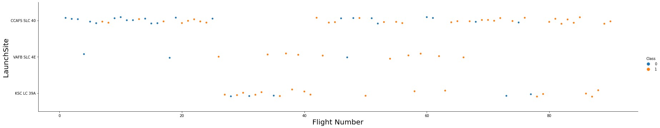
EDA with Data Visualization
To explore data, scatterplots and barplots were used to visualize the relationship between pair of features:
Payload Mass X Flight Number, Launch Site X Flight Number, Launch Site X Payload Mass, Orbit and Flight Number, Payload and Orbit
Source code: https://github.com/geromeandrew/IBM-Applied-Data-Science-Capstone/blob/main/jupyter-labs-eda-dataviz.ipynb
12

Slide 14
EDA with SQL
The following SQL queries were performed:
Names of the unique launch sites in the space mission;
Top 5 launch sites whose name begin with the string 'CCA’;
Total payload mass carried by boosters launched by NASA (CRS);
Average payload mass carried by booster version F9 v1.1;
Date when the first successful landing outcome in ground pad was achieved;
Names of the boosters which have success in drone ship and have payload mass between 4000 and 6000 kg;
Total number of successful and failure mission outcomes;
Names of the booster versions which have carried the maximum payload mass;
Failed landing outcomes in drone ship, their booster versions, and launch site names for in
year 2015; and
Rank of the count of landing outcomes (such as Failure (drone ship) or Success (ground
pad)) between the date 2010-06-04 and 2017-03-20.
13
•
Source code: https://github.com/geromeandrew/IBM-Applied-Data-Science-Capstone/blob/main/jupyter-labs-eda-sql-coursera_sqllite.ipynb

Slide 15
Build an Interactive Map with Folium
Markers, circles, lines and marker clusters were used with Folium Maps
Markers indicate points like launch sites;
Circles indicate highlighted areas around specific coordinates, like NASA Johnson Space
Center;
Marker clusters indicates groups of events in each coordinate, like launches in a launch site;
and
Lines are used to indicate distances between two coordinates.
Source code: https://github.com/geromeandrew/IBM-Applied-Data-Science-Capstone/blob/main/lab_jupyter_launch_site_location.ipynb

Slide 16
Build a Dashboard with Plotly Dash
The following graphs and plots were used to visualize data
Percentage of launches by site
Payload range
This combination allowed to quickly analyze the relation between payloads and launch sites, helping to identify where is best place to launch according to payloads.
Source code: https://github.com/geromeandrew/IBM-Applied-Data-Science-Capstone/blob/main/spacex_dash_app.py

Slide 17





Predictive Analysis (Classification)
Four classification models were compared: logistic regression, support vector machine, decision tree and k nearest neighbors.
Data preparation and standardization
Comparison of results
Model Training
Source code: https://github.com/geromeandrew/IBM-Applied-Data-Science-Capstone/blob/main/SpaceX_Machine_Learning_Prediction_Part_5.jupyterlite.ipynb

Slide 18
Results
Exploratory data analysis results:
Space X uses 4 different launch sites;
The first launches were done to Space X itself and NASA;
The average payload of F9 v1.1 booster is 2,928 kg;
The first success landing outcome happened in 2015 fiver year after the first launch;
Many Falcon 9 booster versions were successful at landing in drone ships having payload above the average;
Almost 100% of mission outcomes were successful;
Two booster versions failed at landing in drone ships in 2015: F9 v1.1 B1012 and F9 v1.1 B1015;
The number of landing outcomes became as better as years passed.

Slide 19
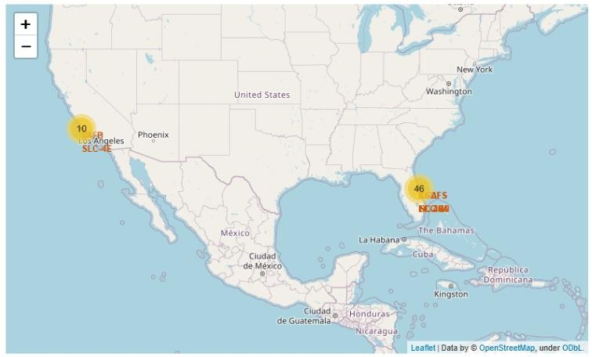
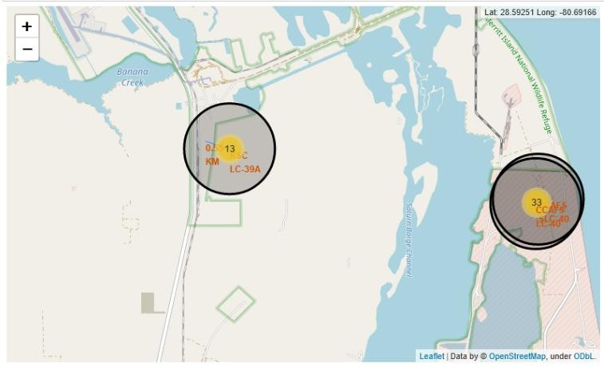
Results
Using interactive analytics was possible to identify that launch sites use to be in
safety places, near sea, for example and have a good logistic infrastructure around.
Most launches happens at east cost launch sites.

Slide 20
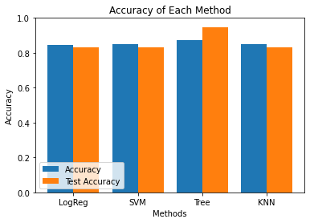
Results
Predictive Analysis showed that Decision Tree Classifier is the best model to predict successful landings, having accuracy over 87% and accuracy for test data over 94%.

Slide 21


Slide 22
Flight Number vs. Launch Site
According to the plot above, it’s possible to verify that the best launch site
nowadays is CCAF5 SLC 40, where most of recent launches were successful;
In second place VAFB SLC 4E and third place KSC LC 39A;
It’s also possible to see that the general success rate improved over time.

Slide 23
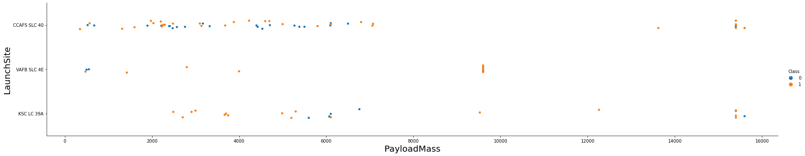
Payload vs. Launch Site
Payloads over 9,000kg (about the weight of a school bus) have excellent success
rate;
Payloads over 12,000kg seems to be possible only on CCAFS SLC 40 and KSC LC
39A launch sites.

Slide 24
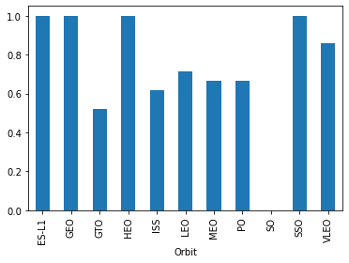
Success Rate vs. Orbit Type
The biggest success rates happens to orbits:
ES-L1;
GEO;
HEO; and
SSO.
Followed by:
VLEO (above 80%); and
LFO (above 70%).

Slide 25
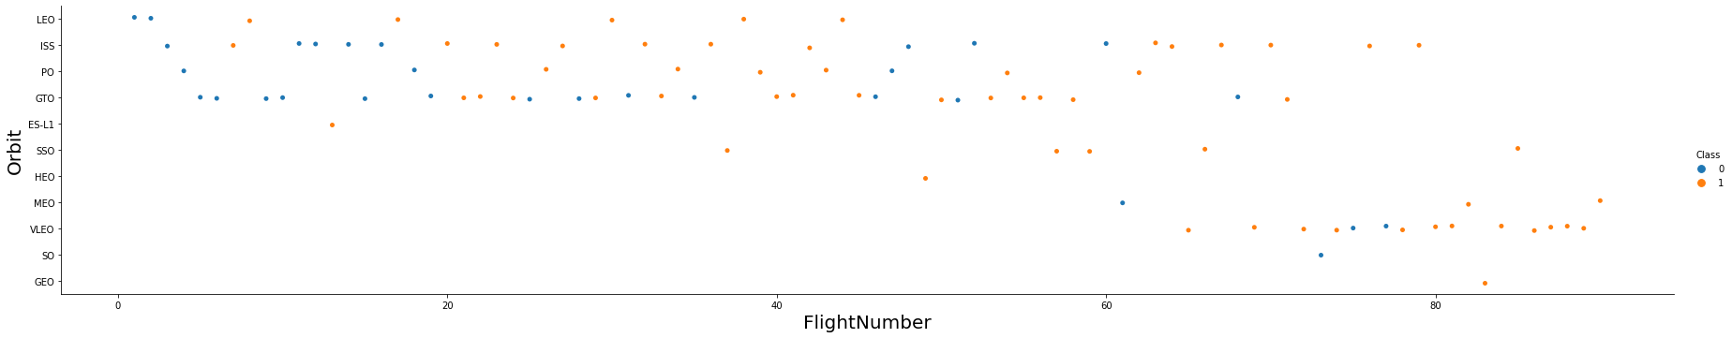
Flight Number vs. Orbit Type
Apparently, success rate improved over time to all orbits;
VLEO orbit seems a new business opportunity, due to recent increase of its
frequency.

Slide 26
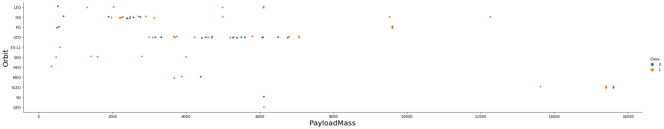
Payload vs. Orbit Type
Apparently, there is no relation between payload and success rate to orbit GTO;
ISS orbit has the widest range of payload and a good rate of success;
There are few launches to the orbits SO and GEO.

Slide 27
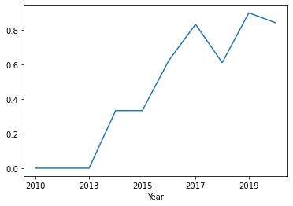
Launch Success Yearly Trend
Success rate started increasing in 2013 and
kept until 2020;
It seems that the first three years were a period of adjusts and improvement of technology.

Slide 28
All Launch Site Names
According to data, there are four launch sites:
Launch Site
CCAFS LC-40
CCAFS SLC-40
KSC LC-39A
VAFB SLC-4E
They are obtained by selecting unique occurrences of “launch_site” values
from the dataset.

Slide 29
Launch Site Names Begin with 'CCA'
5 records where launch sites begin with `CCA`:
Date | Time UTC | Booster Version | Launch Site | Payload | Payload Mass kg | Orbit | Customer | Mission Outcome | Landing Outcome
2010-06-04 | 18:45:00 | F9 v1.0 B0003 | CCAFS LC-40 | Dragon Spacecraft Qualification Unit | 0 | LEO | SpaceX | Success | Failure (parachute)
2010-12-08 | 15:43:00 | F9 v1.0 B0004 | CCAFS LC-40 | Dragon demo flight C1, two CubeSats, barrel of Brouere cheese | 0 | LEO (ISS) | NASA (COTS) NRO | Success | Failure (parachute)
2012-05-22 | 07:44:00 | F9 v1.0 B0005 | CCAFS LC-40 | Dragon demo flight C2 | 525 | LEO (ISS) | NASA (COTS) | Success | No attempt
2012-10-08 | 00:35:00 | F9 v1.0 B0006 | CCAFS LC-40 | SpaceX CRS-1 | 500 | LEO (ISS) | NASA (CRS) | Success | No attempt
2013-03-01 | 15:10:00 | F9 v1.0 B0007 | CCAFS LC-40 | SpaceX CRS-2 | 677 | LEO (ISS) | NASA (CRS) | Success | No attemp
Here we can see five samples of Cape Canaveral launches.

Slide 30
Total Payload Mass
Total payload carried by boosters from NASA:
Total Payload (kg)
111.268
Total payload calculated above, by summing all payloads whose codes
contain ‘CRS’, which corresponds to NASA.

Slide 31
Average Payload Mass by F9 v1.1
Average payload mass carried by booster version F9 v1.1:
Avg Payload (kg)
2.928
Filtering data by the booster version above and calculating the average
payload mass we obtained the value of 2,928 kg.

Slide 32
First Successful Ground Landing Date
First successful landing outcome on ground pad:
Min Date
2015-12-22
By filtering data by successful landing outcome on ground pad and getting the minimum value for date it’s possible to identify the first occurrence, that happened on 12/22/2015.

Slide 33
Successful Drone Ship Landing with Payload between 4000 and 6000
Boosters which have successfully landed on drone ship and had payload mass greater than 4000 but less than 6000
Booster Version
F9 FT B1021.2
F9 FT B1031.2
F9 FT B1022
F9 FT B1026
Selecting distinct booster versions according to the filters above, these 4 are the result.

Slide 34
Total Number of Successful and Failure Mission Outcomes
Number of successful and failure mission outcomes:
Mission Outcome | Occurrences
Success | 99
Success (payload status unclear) | 1
Failure (in flight) | 1
Grouping mission outcomes and counting records for each group led us to the summary above.

Slide 35
Boosters Carried Maximum Payload
Boosters which have carried the maximum payload mass
Booster Version (...)
F9 B5 B1048.4
F9 B5 B1048.5
F9 B5 B1049.4
F9 B5 B1049.5
F9 B5 B1049.7
F9 B5 B1051.3
Booster Version
F9 B5 B1051.4
F9 B5 B1051.6
F9 B5 B1056.4
F9 B5 B1058.3
F9 B5 B1060.2
F9 B5 B1060.3
These are the boosters which have carried the maximum payload mass registered in the dataset.

Slide 36
2015 Launch Records
Failed landing outcomes in drone ship, their booster versions, and launch site names for in year 2015
Booster Version | Launch Site
F9 v1.1 B1012 | CCAFS LC-40
F9 v1.1 B1015 | CCAFS LC-40
The list above has the only two occurrences.

Slide 37
Rank Landing Outcomes Between 2010-06-04 and 2017-03-20
Ranking of all landing outcomes between the date 2010-06-04 and 2017-
03-20:
Landing Outcome | Occurrences
No attempt | 10
Failure (drone ship) | 5
Success (drone ship) | 5
Controlled (ocean) | 3
Success (ground pad) | 3
Failure (parachute) | 2
Uncontrolled (ocean) | 2
Precluded (drone ship) | 1
This view of data alerts us that “No attempt” must be taken in account.

Slide 38


Slide 39
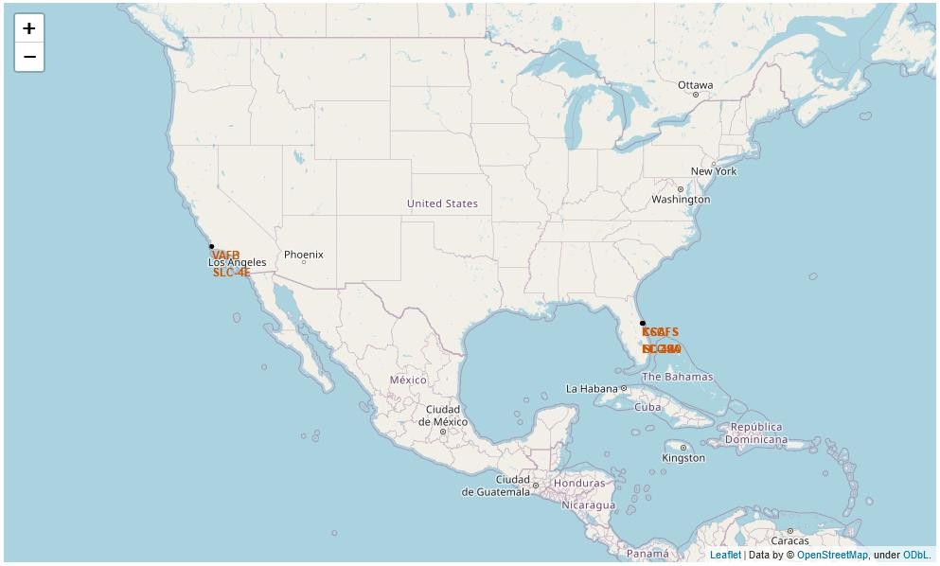
All launch sites
Launch sites are near sea, probably by safety, but not too far from roads and
railroads.
38

Slide 40

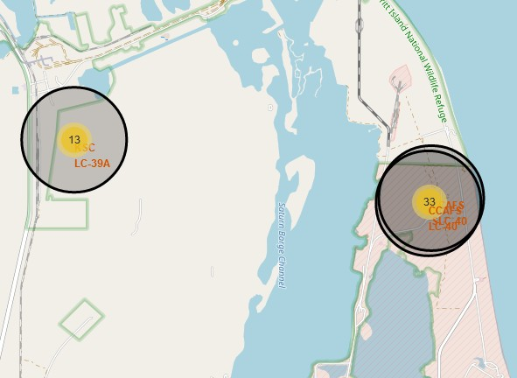
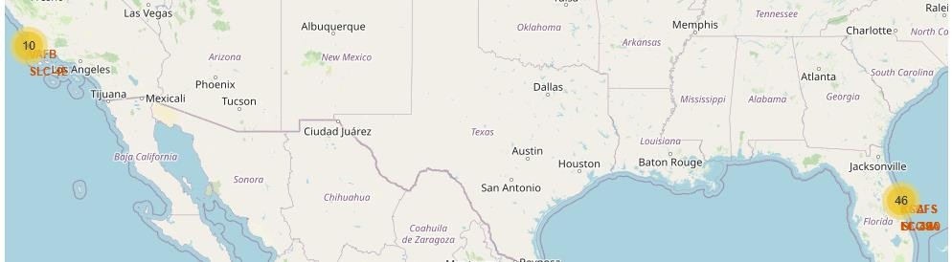

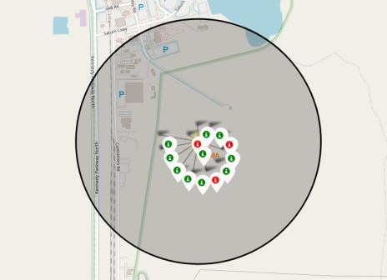
Launch Outcomes by Site
Example of KSC LC-39A launch site launch outcomes
Green markers indicate successful and red ones indicate failure.

Slide 41
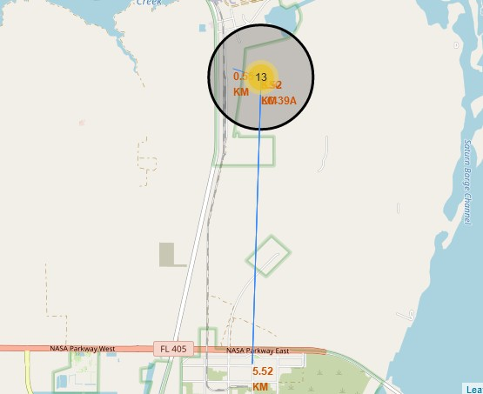
Logistics and Safety
Launch site KSC LC-39A has good logistics aspects, being near railroad and road and relatively far from inhabited areas.

Slide 42


Slide 43
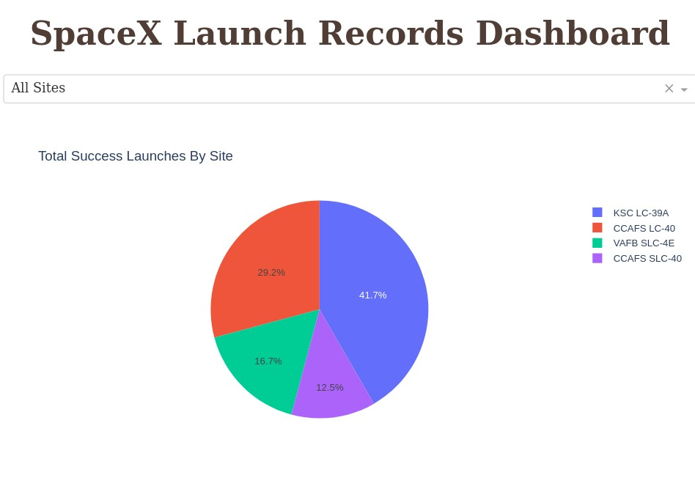
Successful Launches by Site
The place from where launches are done seems to be a very important factor of
success of missions.

Slide 44
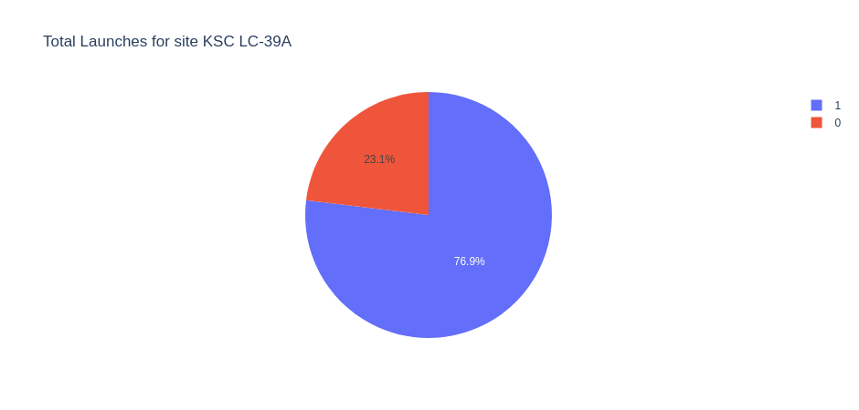
Launch Success Ratio for KSC LC-39A
76.9% of launches are successful in this site.

Slide 45
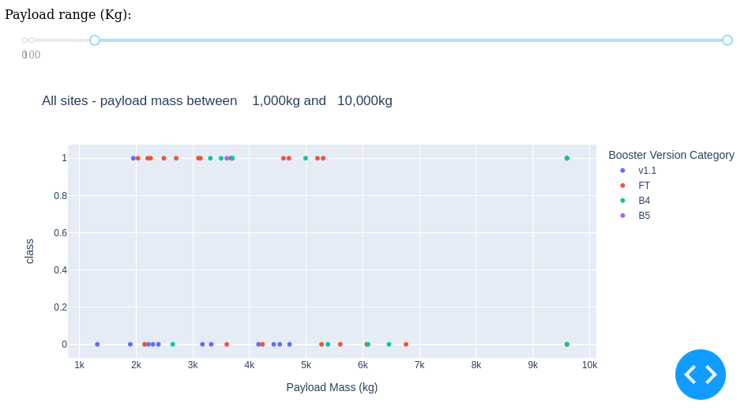
Payload vs. Launch Outcome
Payloads under 6,000kg and FT boosters are the most successful combination.

Slide 46
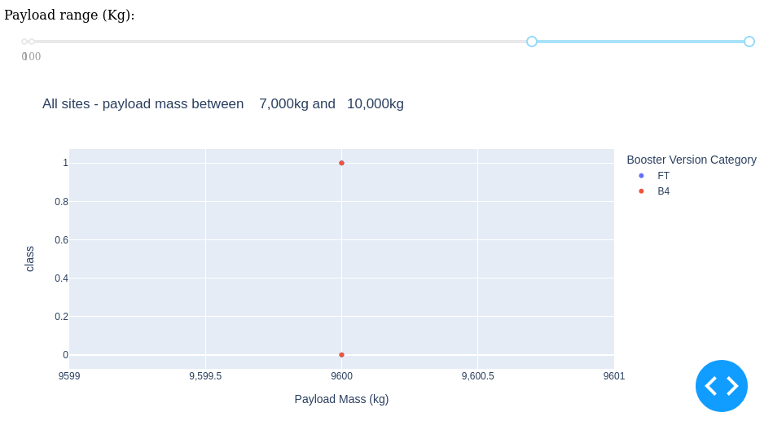
Payload vs. Launch Outcome
There’s not enough data to estimate risk of launches over 7,000kg

Slide 47


Slide 48
Classification Accuracy
Four classification models were tested, and their accuracies are plotted beside;
The model with the highest classification accuracy is Decision Tree Classifier, which has accuracies over than 87%.

Slide 49
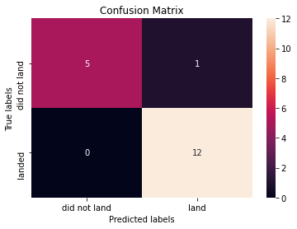
Confusion Matrix of Decision Tree Classifier
Confusion matrix of Decision Tree Classifier proves its accuracy by showing the big
numbers of true positive and true negative compared to the false ones.

Slide 50
Conclusions
Different data sources were analyzed, refining conclusions along the
process;
The best launch site is KSC LC-39A;
Launches above 7,000kg are less risky;
Although most of mission outcomes are successful, successful landing outcomes seem to improve over time, according the evolution of processes and rockets;
Decision Tree Classifier can be used to predict successful landings and
increase profits.

Slide 51
Appendix
As an improvement for model tests, it’s important to set a value to
np.random.seed variable;
Folium didn’t show maps on Github, so I took screenshots.

Slide 52
